Slide 1


Building a Robust Account Management System with Object-Oriented Design
In today's digital banking landscape, efficient and secure account management is crucial. Our Account Management System leverages the key principles of object-oriented programming - abstraction, encapsulation, inheritance, and polymorphism - to deliver a robust and flexible solution for managing bank accounts and transactions. By applying these fundamental OOP concepts, we've created a system that simplifies user interactions, ensures data integrity, promotes code reuse, and enhances overall extensibility.

Slide 2
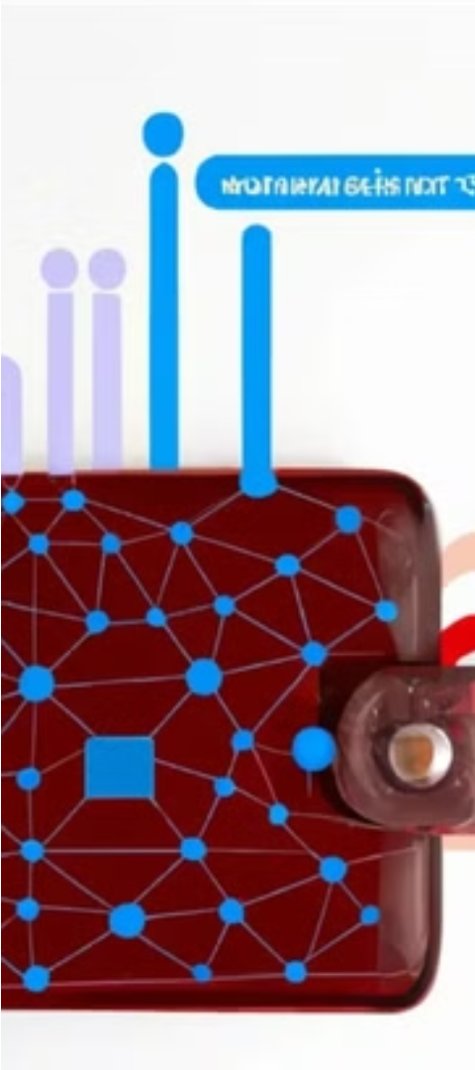
Abstraction: Simplifying Complex Interactions
Account Class Abstraction
Transaction Abstraction
The Account class abstracts the complex details of bank account management, providing a simple and intuitive interface for users to Withdraw, Deposit, and Print account information. This high-level abstraction hides the internal implementation, allowing users to focus on the essential account operations without being burdened by the underlying complexities.
Similarly, the Transaction class abstracts various transaction types, such as DepositTransaction, WithdrawTransaction, and TransferTransaction. Users can interact with these transactions without needing to know the specific details of how each type is processed, streamlining the overall user experience.

Slide 3
Encapsulation: Protecting Object Integrity
Account Encapsulation
Transaction Encapsulation
The Account class encapsulates crucial account details, such as the account name and balance, restricting direct access to these internal fields. Users can only interact with the account through the public methods Withdraw and Deposit, ensuring data integrity and preventing unauthorized modifications.
The Transaction class also employs encapsulation, controlling access to transaction details and managing the execution and rollback logic internally. This protects the integrity of the transaction data and ensures that the overall system operates as expected, even in the face of complex scenarios.

Slide 4
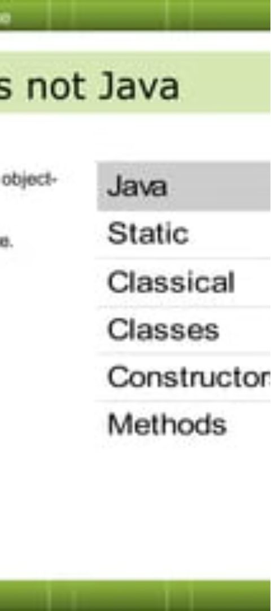
Inheritance: Promoting Code Reuse
1
Transaction Base Class
The Transaction class serves as the base class for all specific transaction types, such as DepositTransaction, WithdrawTransaction, and TransferTransaction. This inheritance structure allows the derived classes to inherit common logic and behavior from the base class, promoting code reuse and simplifying maintenance.
2
Overriding Specific Behaviors
The derived transaction classes override the abstract methods in the base class, such as Execute and Print, to implement their unique behaviors. This modular design makes the system more flexible and extensible, as new transaction types can be easily added without affecting the existing codebase.
3
Simplified Maintenance
By leveraging inheritance, changes to the common logic in the base class can be easily propagated to the derived classes, reducing the overall maintenance burden and ensuring consistency across the entire system.

Slide 5



Polymorphism: Enhancing Flexibility and Extensibility
Uniform Transaction Handling
Enhanced Extensibility
Increased Flexibility
This polymorphic design enhances the overall extensibility of the system. As new transaction types are added, they can be easily integrated into the existing codebase by implementing the required abstract methods, without the need to modify the existing code that interacts with the Transaction class.
The polymorphic capabilities of the Transaction class provide a high degree of flexibility, allowing the system to easily adapt to changing requirements or new use cases. The uniform interface enables seamless integration of new transaction types, ensuring the system remains robust and scalable over time.
The polymorphic nature of the Transaction class allows for uniform handling of different transaction types. The abstract Execute and Print methods in the base class are overridden by the derived transaction classes, enabling a consistent interface for executing and printing transactions, regardless of their specific type.

Slide 6




Implementing Object-Oriented Principles
Abstraction
Encapsulation
Inheritance
Polymorphism
The Account and Transaction classes simplify account and transaction management by hiding complex internal details and providing high-level interfaces for users to interact with the system.
The private fields in the Account class are accessed only through public methods, ensuring data integrity and preventing unauthorized modifications.
The Transaction base class provides common logic and behavior, which are inherited by the derived transaction types, promoting code reuse and simplifying maintenance.
The abstract methods in the Transaction class enable uniform handling of different transaction types, enhancing the system's flexibility and extensibility.

Slide 7
Demonstrating the System in Action
Abstraction in Action
1
Users can easily interact with the Account and Transaction classes, performing common operations like Withdraw, Deposit, and Print without needing to know the underlying implementation details.
2
Encapsulation in Action
The private account details are safely accessed and modified through the public methods, ensuring data integrity and preventing unauthorized changes.
Inheritance in Action
3
The system seamlessly handles different transaction types, such as DepositTransaction and WithdrawTransaction, thanks to the common logic inherited from the base Transaction class.
4
Polymorphism in Action
The uniform interface for executing and printing transactions allows the system to easily adapt to new transaction types without requiring changes to the existing codebase.

Slide 8

Conclusion: Delivering a Robust and Flexible Solution
By applying the key principles of object-oriented programming - abstraction, encapsulation, inheritance, and polymorphism - our Account Management System delivers a robust, flexible, and scalable solution for managing bank accounts and transactions. This structured, modular design simplifies user interactions, ensures data integrity, promotes code reuse, and enhances the overall extensibility of the system, making it a reliable and future-proof banking software solution.

